Slide 1
KAVACH – Factory and Site Acceptance Tests
C Sivakumar Kashyap
DSTE/TCAS/SC
13.08.2022

Slide 2
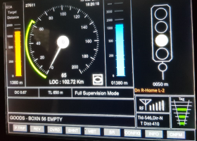
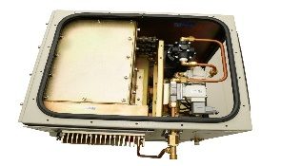
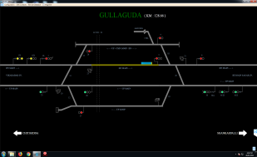
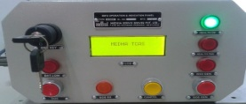


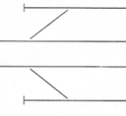

KAVACH – The Basic Flow
SMOCIP
NMS
DMI
BIU
Info Display on DMI
LP Inputs from DMI
Apply Brake on Receiving Command
Display, SoS Button Interface to ASM
Loco KAVACH
Station KAVACH
RIU
Data Exchange Through Radio Link
Inputs from Remote Location
Updates Information Read from RFID Tag
Speed and Direction
Tower
Relay Wiring / Direct EI Interfacing
Relay Wiring
RFID Reader
PG
Reader Reads Tag Information – Location, TIN, Next Tag Distance etc
Signaling Information – ECRs, TPRs, ACPRs, N/RWKRs, LCPRs, LXPRs
RFID Tags

Slide 3
End Objective of Testing
??

Slide 4
End Objective of Testing
System
Safe
Operational Flexibility
Reliable

Slide 5
Conceptualising Testing for Acceptance
Application Design
Design Correction
Design Approval
Compliance
Conformity Testing

Slide 6
Project Execution – Design Deliverables
Absolute Location Info (Firm)
KAVACH Design Deliverables
RFID Tag / TIN Layout
Station KAVACH Application Data
RF Coverage Prediction (Firm)
SIP (SCR)
KAVACH Table of Control
Table of Control (SCR)
Signaling Circuits (SCR)
KAVACH Interface Circuit
Gradients (SCR)
PSR (SCR)
RFID Tag Data
OHE Mast Chainages (SCR)
Working Time Table (SCR)
TDMA / FDMA Scheme

Slide 7
RFID Layout

Slide 8
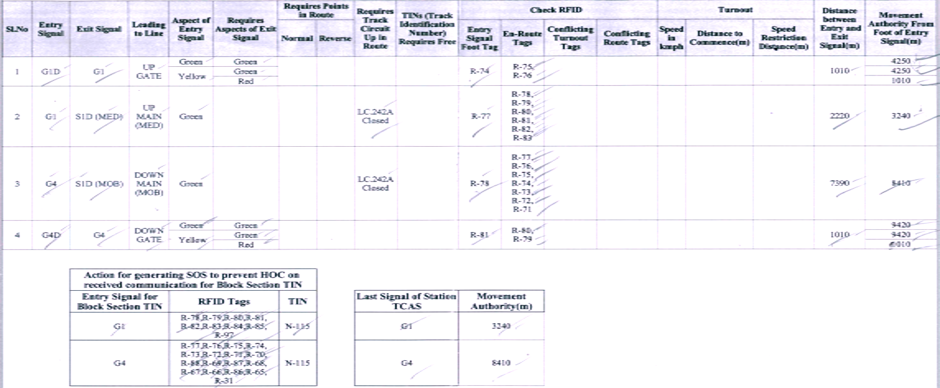
Table of Control

Slide 9
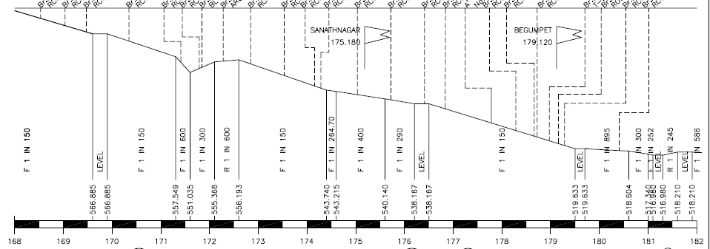
Gradients

Slide 10
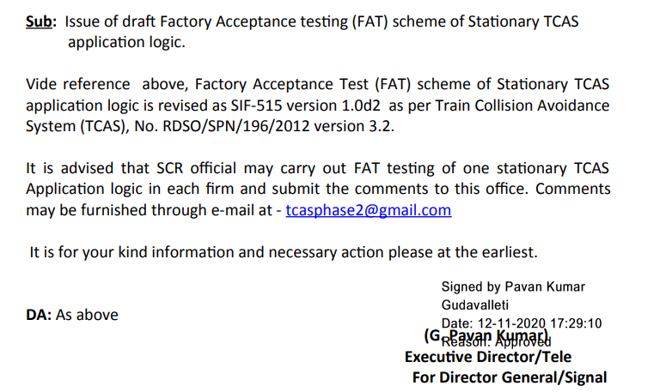
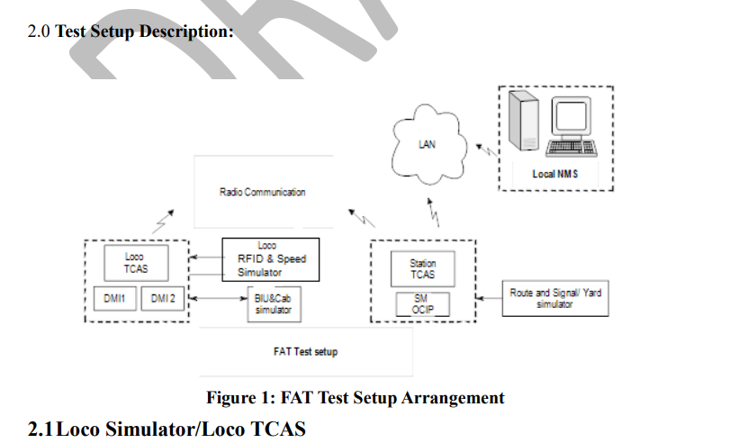
Factory Acceptance Test - RDSO

Slide 11
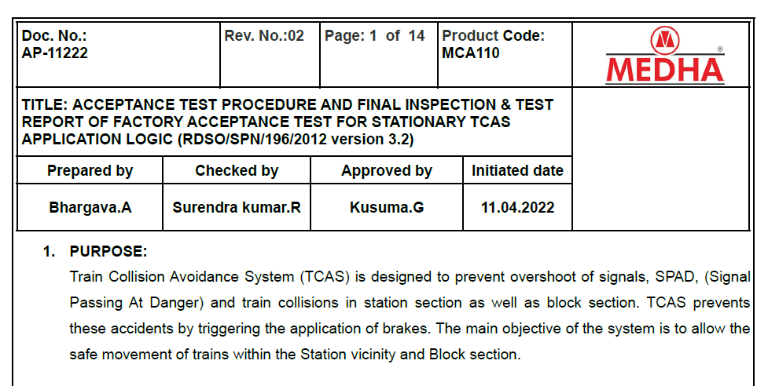
Factory Acceptance Test – Medha
Reference Document – AP-11222 Rev. No. 02 of M/s Medha Servo Drives Private Limited
Based on RDSO FAT Procedure SIF-515 Version 1.0d2

Slide 12
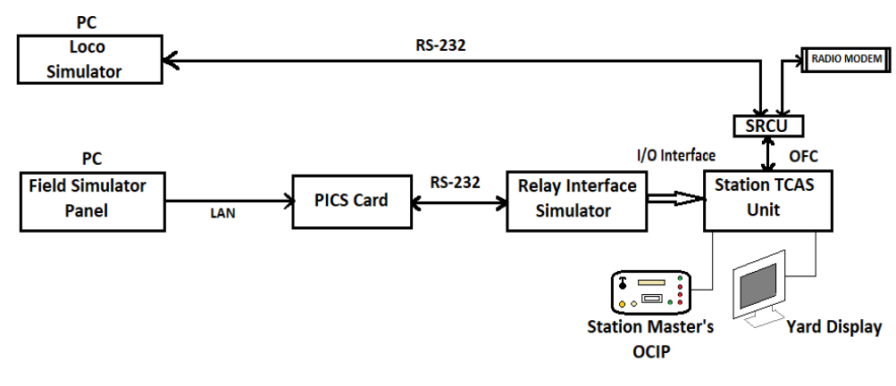
FAT Setup

Slide 13
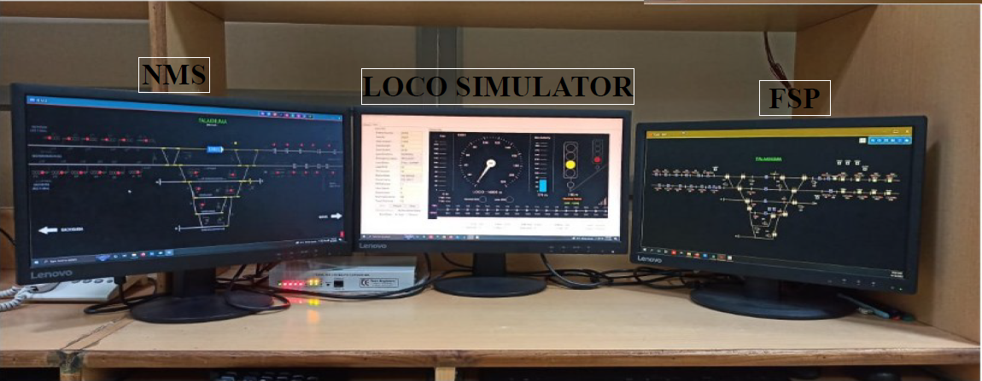
FAT Setup – Desk Arrangements

Slide 14
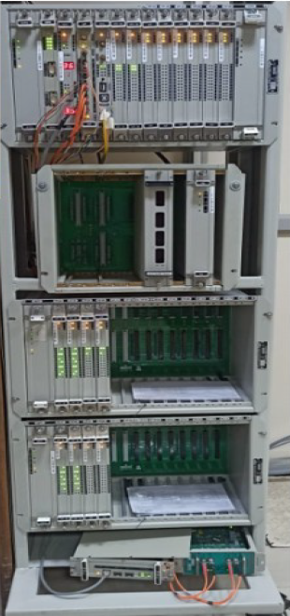
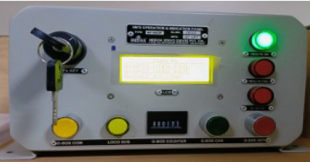
FAT Setup – Out of Desk Arrangements

Slide 15
Loco Simulator
PC Application
Simulates Loco KAVACH functionality
To be configured
Loco ID
Mode
Route
Initial Absolute Location
Train Direction
Speed
Displays
Current Absolute Location
Movement Authority
Signal Aspects
Speed Restriction – Speed and Distance

Slide 16
Loading Application Data
Application data loading into Station KAVACH
To be Checked
Application Data Checksum in SMOCIP
Application Data Checksum in Docklight

Slide 17
Field Simulator Panel

Slide 18
Field Simulator Panel
Functionality
Simulates interlocking inputs to Station KAVACH
Displays station layout
To be Checked
Correctness of layout
Availability of toggling options for all the intended interlocking inputs
Correctness of toggling with NMS

Slide 19
Network Monitoring System

Slide 20
Network Monitoring System
Setup
Connected to Station KAVACH
Runs only one station unlike field deployment
To be Checked
Correctness of layout
Correctness of toggling of inputs from FSP

Slide 21
Table of Control

